Slide 1

Title: Landslide Monitoring And Alerting System Using IoT Domain: Internet Of Things
PRESENTED BY
PALAPALA BHARATH KUMAR REDDY U21EC203
PRADEEP NAMOJU U21EC228
SANDURI ASHOK KUMAR U21EC239
GUIDED BY
Dr.M.NAGARAJAN

Slide 2
AGENDA
Introduction
Problem statement
Proposed Methodology
System Architecture
Hardware/Software Description
Future Scope
Conclusion

Slide 3
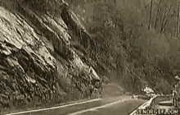
INTRODUCTION:
A landslide is defined as the movement of a mass of rock, debris, or earth down a slope. Landslides are a type of "mass wasting," which denotes any down-slope movement of soil and rock under the direct influence of gravity.
Different Climatic Conditions also result in landslide events.

Slide 4
Problem Statement:
Landslides are among the most devastating natural disasters, causing significant loss of life, property damage, and environmental destruction.
The problem statement for landslides is that they can cause significant damage to the environment, infrastructure, and people.
Landslide can cause Infrastructure damage, Human damage, Health damage, Essential services like water, electricity, communication lines.
To reduce the impact of landslides, it's important to be able to predict them so that preventative action can be taken.

Slide 5
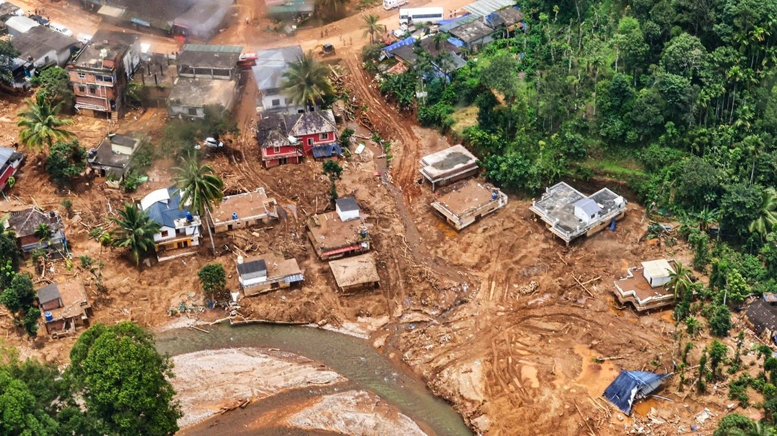
Kerala-Wayanad Landslide - 1

Slide 6
Proposed Methodology:
The Proposed methodology for the "Landslide Monitoring and Alerting System using IoT" involves integrating sensors like soil moisture, vibration, rain detectors, and ultrasonic sensors with Arduino and NodeMCU for data collection.
The NodeMCU transmits real-time data to the cloud for monitoring via the Blynk app.
Alerts are triggered based on predefined sensor thresholds, notifying users of potential landslide risks. The system allows continuous monitoring and real-time alerts to help prevent landslide disasters effectively.

Slide 7
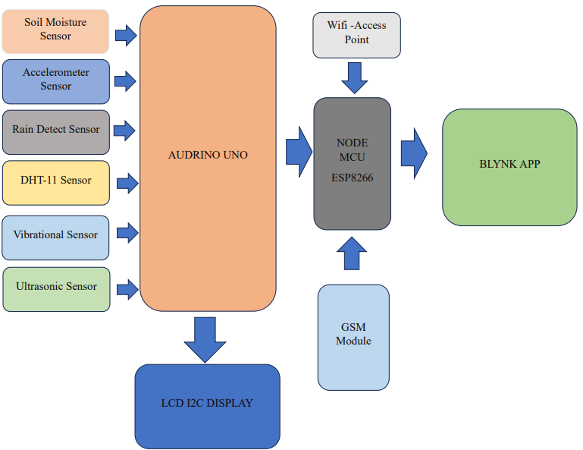
System Architecture:

Slide 8
Hardware Description
Arduino Uno (Microcontroller)
NodeMCU (ESP8266)
Vibration Sensor
Soil Moisture Sensor
Rain Detector Sensor
DHT11 Sensor
I2C LCD Display
Power Supply OF AND ENGINEERING

Slide 9
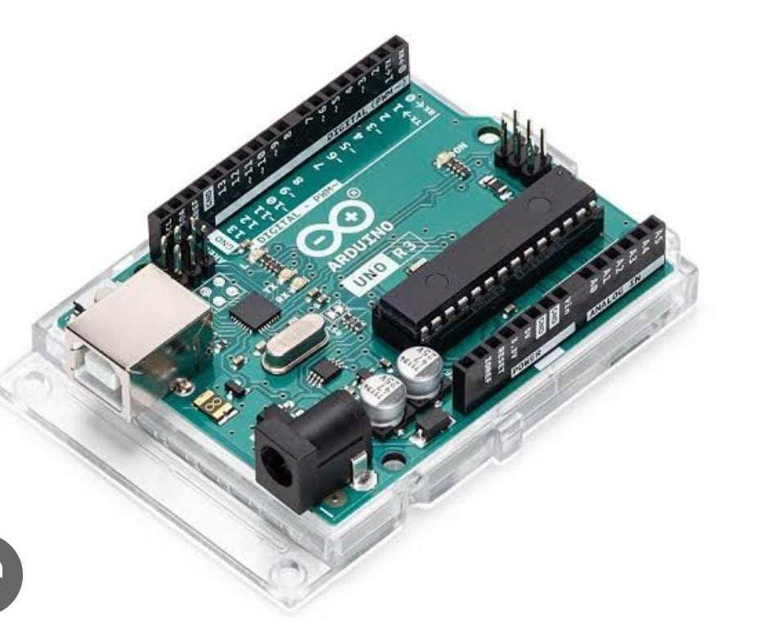
Arduino Uno:
The Arduino Uno R3 is a microcontroller board based on a removable, dualinline-package (DIP) ATmega328 AVR microcontroller. It has 20 digital input/output pins (of which 6 can be used as PWM outputs and 6 can be used as analog inputs). Programs can be loaded on to it from the easy-to-use.

Slide 10
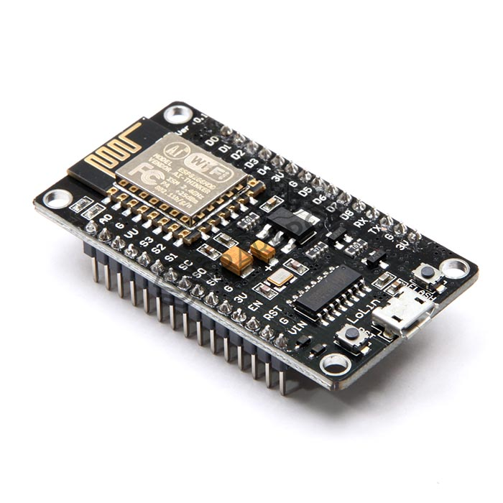
NodeMCU [ESP8266] :
The NodeMCU (Node MicroController Unit) is an open-source software and hardware development environment built around an inexpensive System-on-a-Chip (SoC) called the ESP8266. The ESP8266, designed and manufactured by Espressif Systems, contains the crucial elements of a computer: CPU, RAM, networking (WiFi), and even a modern operating system and SDK. That makes it an excellent choice for Internet of Things (IoT) projects of all kinds.

Slide 11
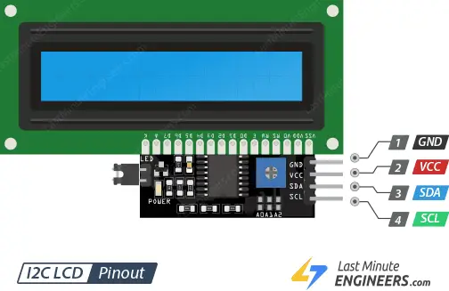
LCD Display:
A liquid-crystal display is a flat-panel display or other electronically modulated optical device that uses the light-modulating properties of liquid crystals combined with polarizers. Liquid crystals do not emit light directly but instead use a backlight or reflector to produce images in color or monochrome.

Slide 12
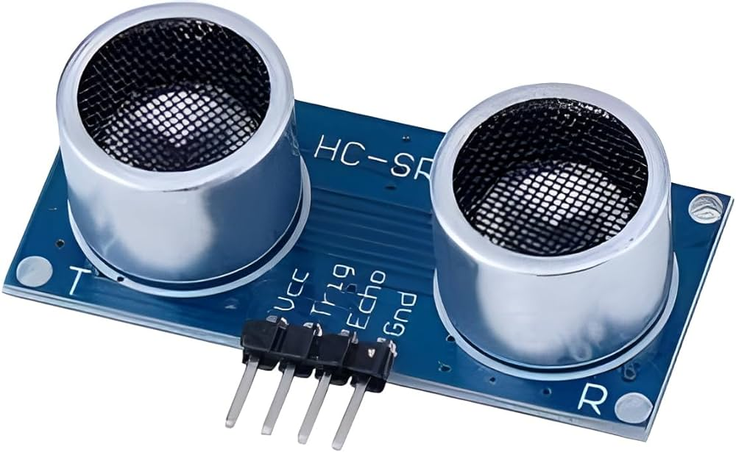
Ultrasonic Sensor:
An electronic instrument that uses ultrasonic sound waves (through air) to measure the distance of the target object and the reflected sound is converted into electrical signal.

Slide 13
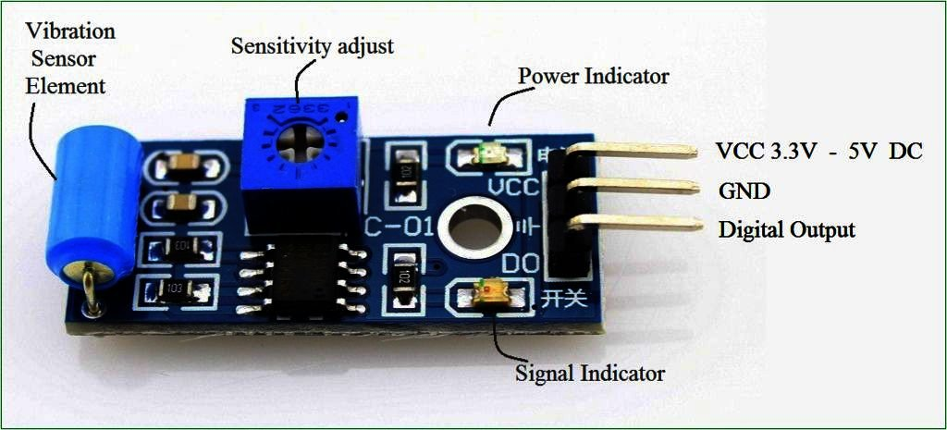
Vibrational Sensor:
Vibration sensors are devices that detect vibration, shock, and sound. They can be used in machinery to detect problems before they happen. Vibration sensors work by detecting the motion of a material or object by sensing its frequency. The faster the movement, the higher the frequency detected on a vibration sensor.

Slide 14
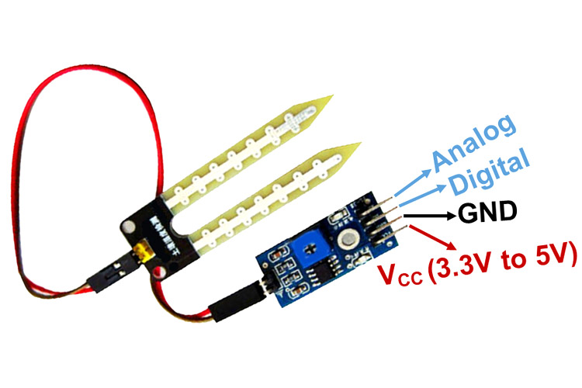
Soil Moisture Sensor:
Soil moisture sensors measure the water content in the soil and can be used to estimate the amount of stored water in the soil horizon. Soil moisture sensors do not measure water in the soil directly. Instead, they measure changes in some other soil property that is related to water content in a predictable way.

Slide 15
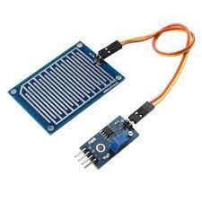
Rain Detect Sensor:
A rain sensor is one kind of switching device which is used to detect the rainfall. It works like a switch and the working principle of this sensor is, whenever there is rain, the switch will be normally closed..

Slide 16
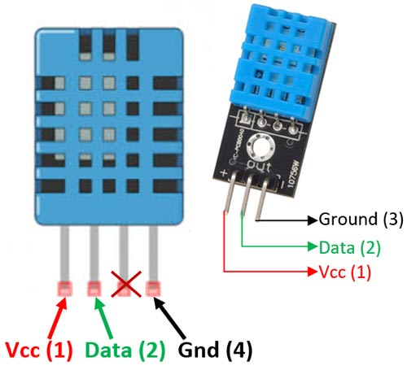
DHT-11 Sensor:
The DHT11 is a basic, ultra low-cost digital temperature and humidity sensor. It uses a capacitive humidity sensor and a thermistor to measure the surrounding air and spits out a digital signal on the data pin (no analog input pins needed).

Slide 17
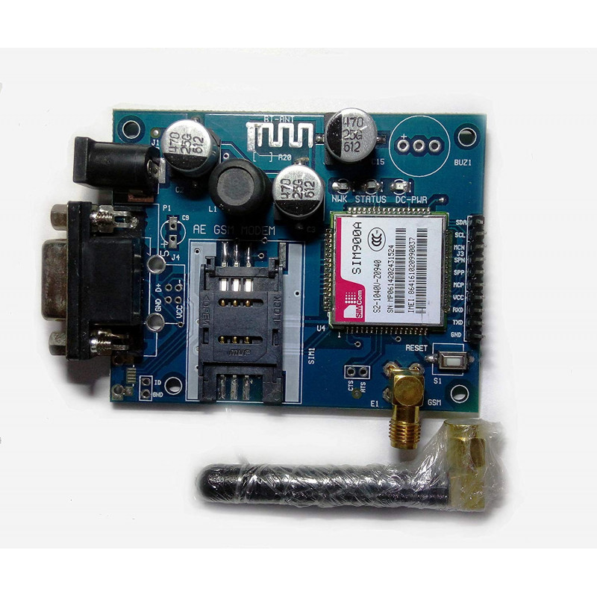
GSM SIM900A:
SIM900A Modem is built with Dual Band GSM/GPRS based SIM900A modem from SIMCOM. It works on frequencies 900/ 1800 MHz. SIM900A can search these two bands automatically. The frequency bands can also be set by AT Commands. The baud rate is configurable from 1200-115200 through AT command.

Slide 18
Software Description : 1.Blynk App
Blynk is an Internet of Things (IoT) platform that enables users to control, monitor, and manage devices through a smartphone or web interface. It allows you to create mobile and web apps to interact with hardware like microcontrollers (e.g., ESP8266, ESP32, Arduino) over the internet.
2. Audrino IDE
Arduino Integrated Development Environment (IDE) is an open source IDE that allows users to write code and upload it to any Arduino board.

Slide 19
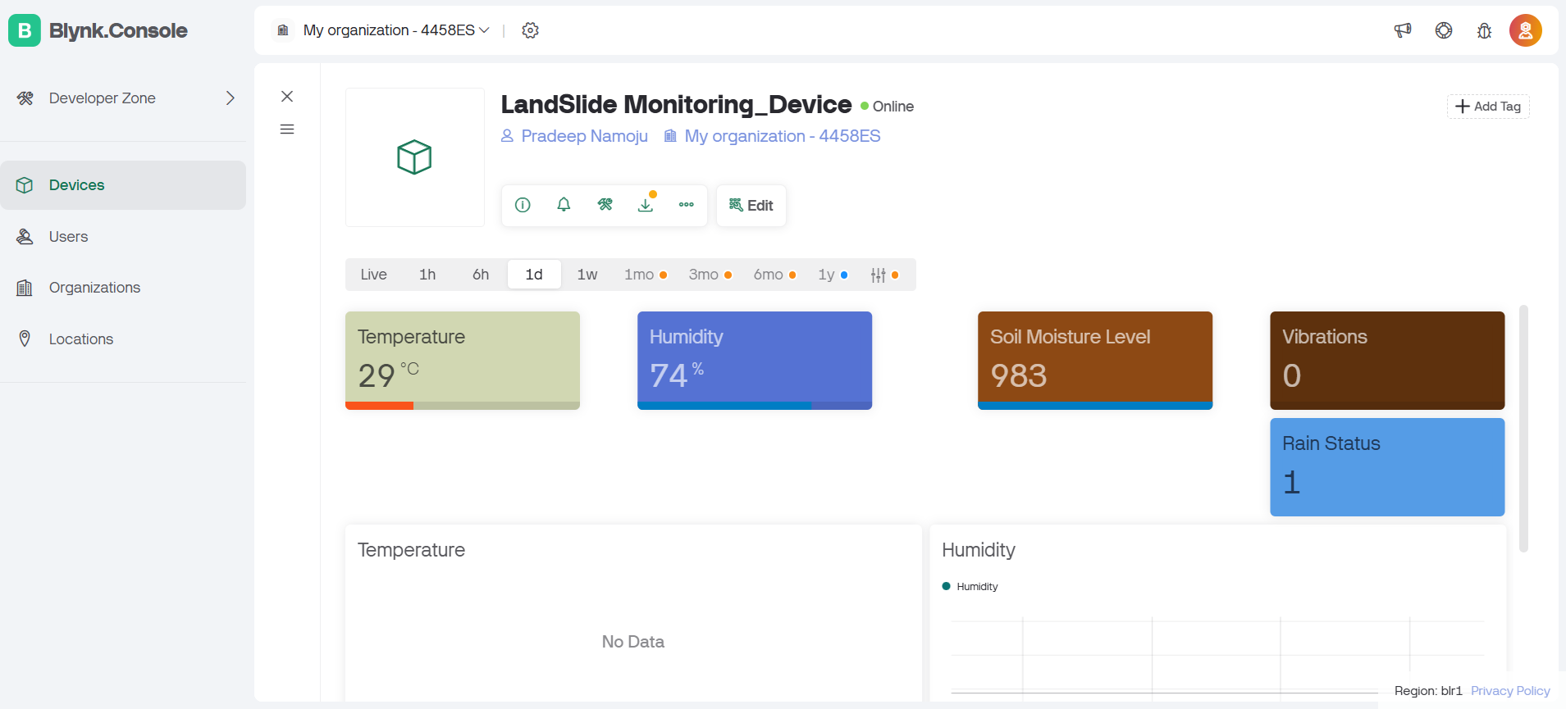
Results:

Slide 20
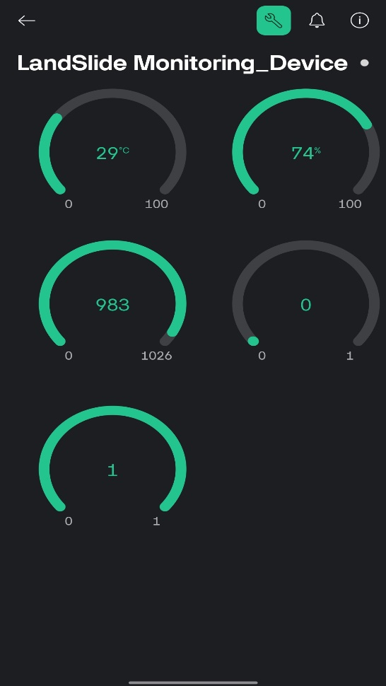
Results:

Slide 21
Future Work
Integration with satellite data: By integrating the system with satellite data, the accuracy of landslide detection and monitoring can be improved. Satellite data can provide information on factors such as soil moisture, land cover, and slope, which can be used to predict the likelihood of a landslide.
Mobile app integration: Developing a mobile app for the system can provide users with easy access to real-time data and alerts. This can be especially useful for authorities responsible for monitoring landslide-prone areas. • Use of additional sensors: Additional sensors such as GPS, pressure sensors, and temperature sensors can be integrated into the system to provide more accurate and comprehensive data. This can help in improving the accuracy of the ML algorithms used in the system.
Cloud integration: The system can be integrated with cloud services to store data and enable remote access. This can provide a more scalable and cost-effective solution for storing and processing large amounts of data.
Integration with drones: Drones can be used to collect data on the terrain and geological features in landslide prone areas. This data can be used to improve the accuracy of the ML algorithms and predictive models used in the system.

Slide 22
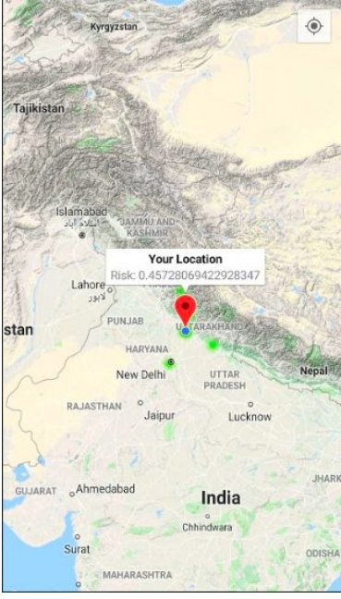
Future Work
Building Dedicated Wensite with Full Stack Development
Integrating Auzre Maps

Slide 23
Conclusion
The Landslide Detection and Monitoring System aims to predict and monitor landslides in real-time using advanced sensors and technology. By analyzing environmental data like ground movement and rainfall, it provides early warnings to help reduce risks to lives and infrastructure. This scalable, cost-effective solution enhances disaster preparedness and ensures timely responses in vulnerable regions, contributing to safer and more resilient communities.

Slide 24


